Slide 1
昇思Mind Spore技术公开课大模型专题
Parameter-Efficient Fine-Tuning (PEFT)

Slide 2
What is Fine-tuning
Fine-tuning is the process of taking a model that is already trained on some task and then tweaking it to perform a similar task. It is often used when a new dataset or task requires the model to have some modifications, or when the model is not performing well on a specific task.
For example, a model trained to generate stories can be fine-tuned to generate poems. This is possible because the model has already learned how to generate casual language and write stories, this skill can also be used to generate poems if the model is tweaked properly.

Slide 3
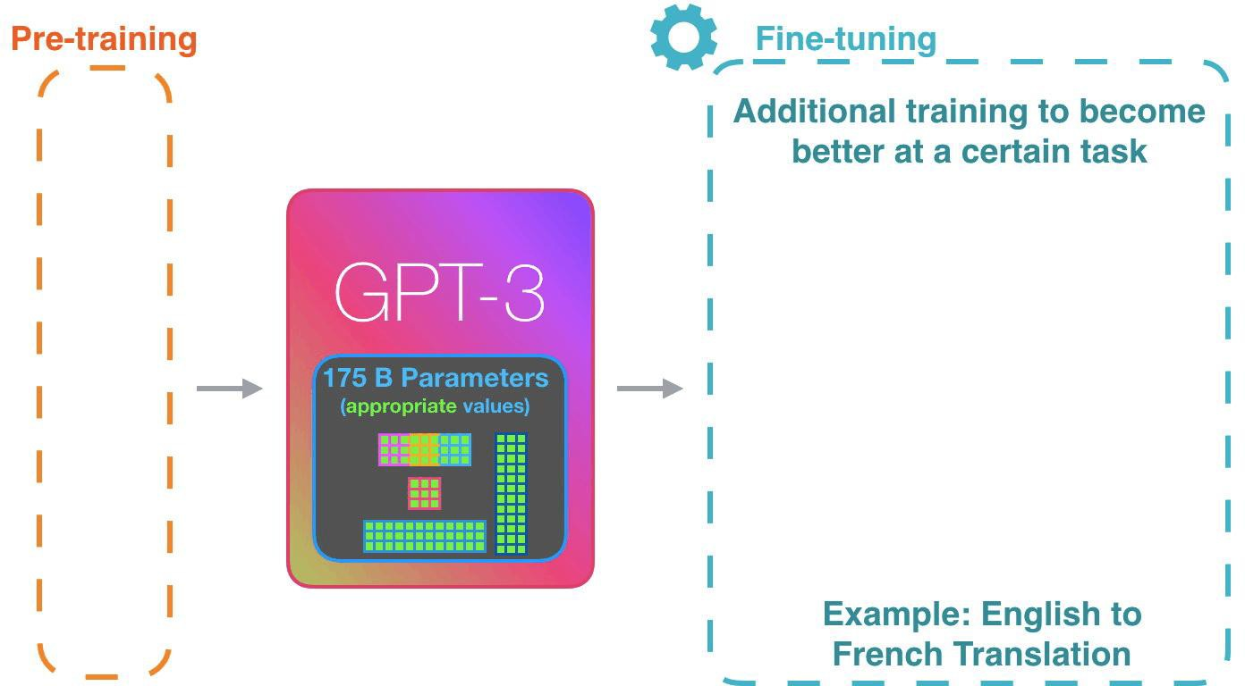
How does Fine-tuning work?
taking the weights of the original model and adjusting them to fit a new task.

Slide 4
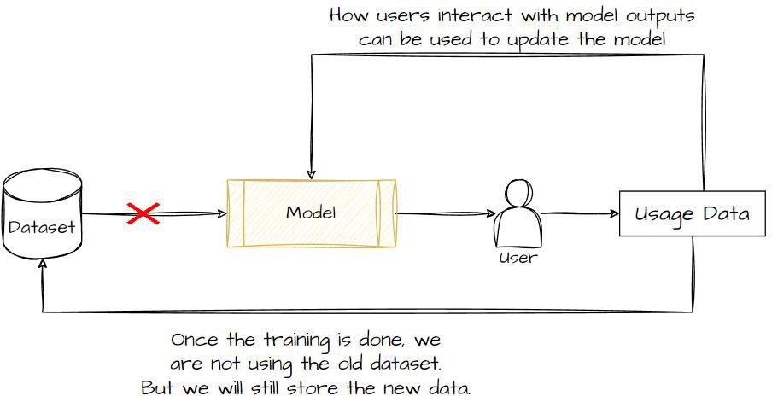
Why use Fine-Tuning?
Larger models generalize to downstream tasks well
Cheaper than training a whole model
Good for online training

Slide 5
Use a LLM when you get some data.
Prompt engineering
Doesn’t always work
Tedious to find a good prompt
Finetune the full LM on your data
Expensive
Overfitting / catastrophic forgetting on small datasets
Need to store one full set of model weights per task
Parameter-efficient Fine-tuning (PEFT)

Slide 6
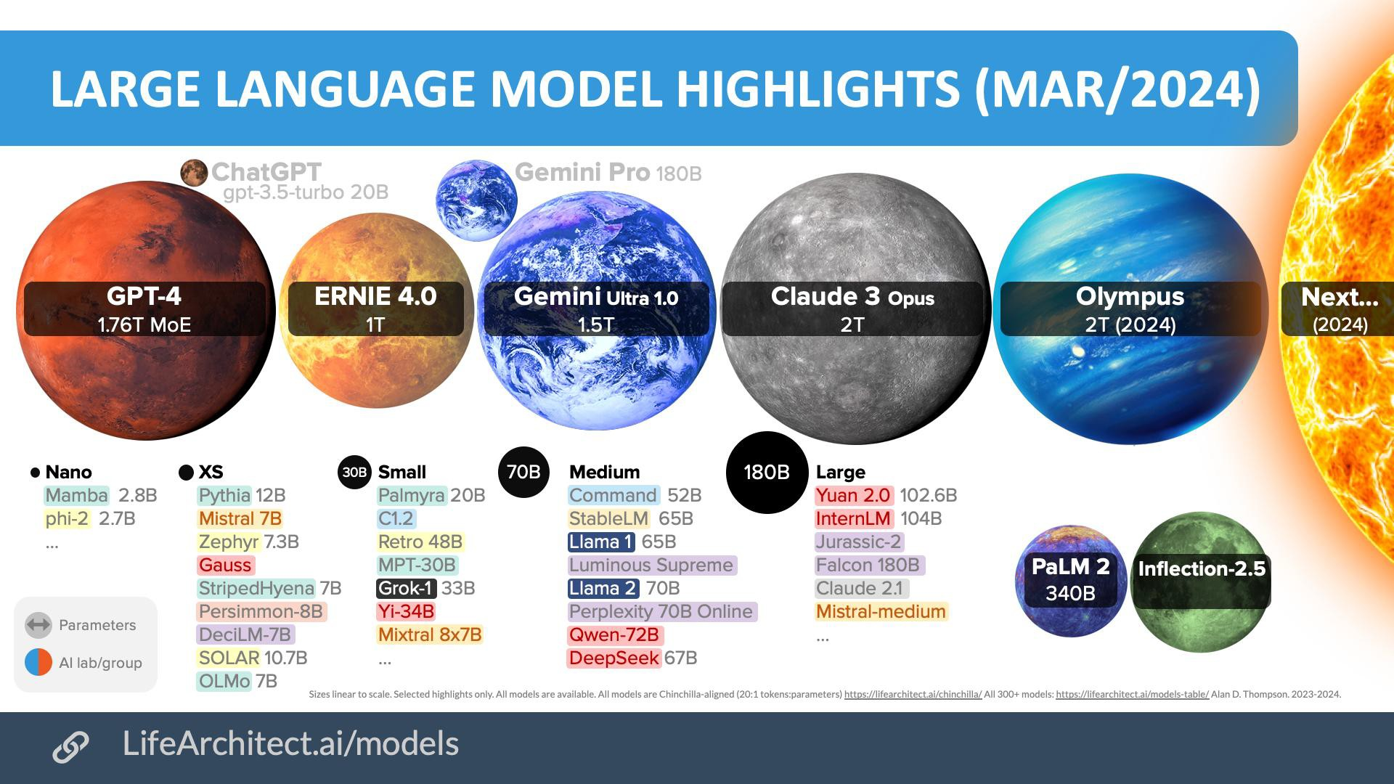
What is PEFT?
PEFT, Parameter Efficient Fine-Tuning, is a set of techniques or methods to fine- tune a large model in the most compute and time-efficient way possible, without losing any performance which you might see from full fine-tuning.

Slide 7
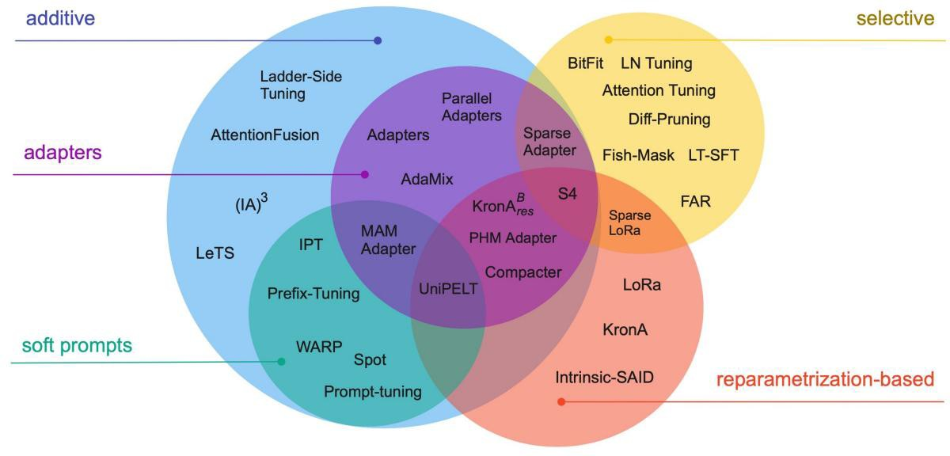
PEFT Methods

Slide 8
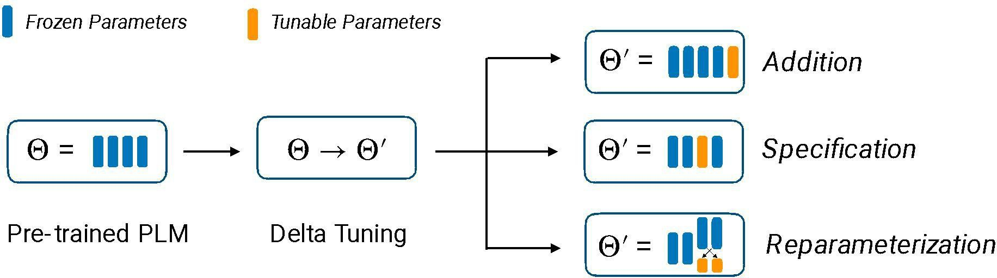
PEFT Methods
Addition: What if we introduce additional trainable parameters to the neural network and just train those?
Specification: What if we pick a small subset of the parameters of the neural network and just tune those?
Reparameterization: What if we re-parameterize the model into something that is more efficient to train?
PEFT

Slide 9
What if we introduce additional trainable parameters to the neural network and just train those?
Methods: prompt tuning, prefix tuning, adapters, and compacters

Slide 10
Prompt Tuning
Finetune T5 to act a bit more like a traditional language model.
This only needs to be done once, and empirically makes prompt tuning working better.
This is probably because the span-corruption objective with which T5 was originally trained isn’t amenable to prompting.
Freeze the weights of T5. Set the first k input embeddings to be learnable.
k is a hyperparameter up to the choice of the implementer.
Initialize the k learnable embeddings. Some options include:
Random initialization
Initialize to values drawn from the vocabulary embedding matrix
Train on your task specific data.

Slide 11
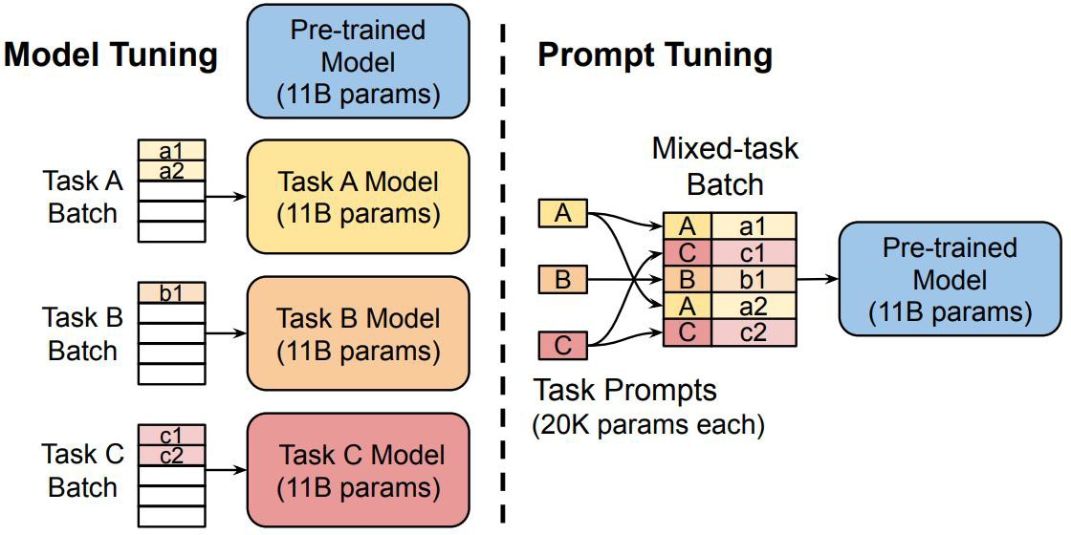
Prompt Tuning

Slide 12
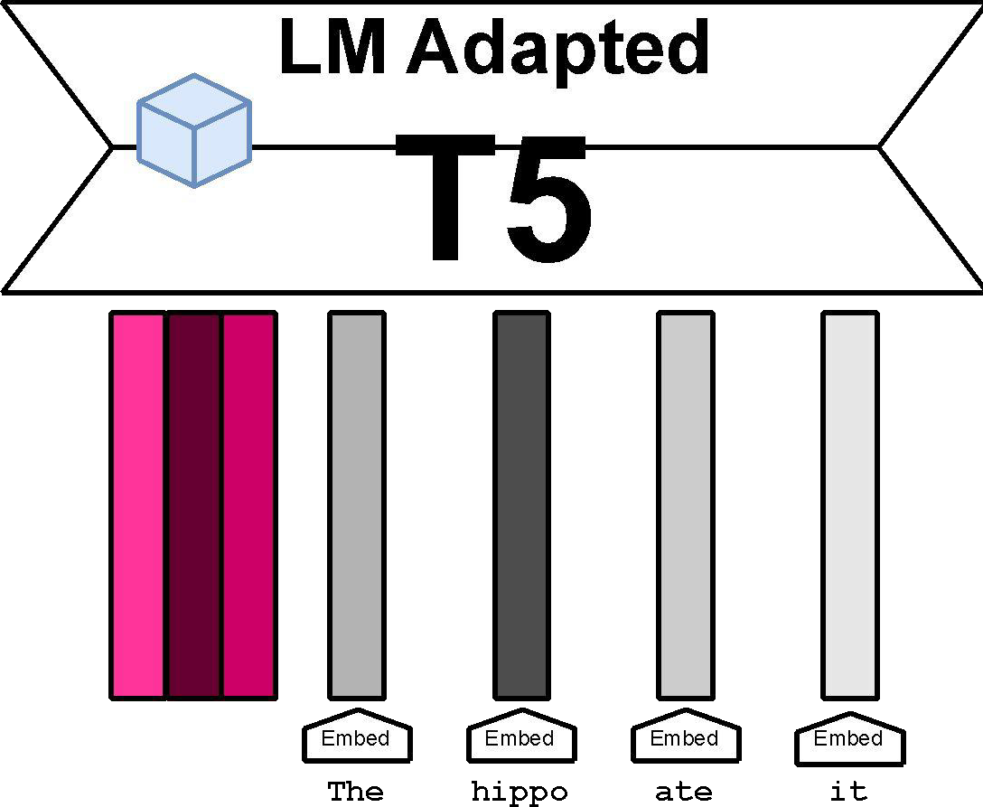
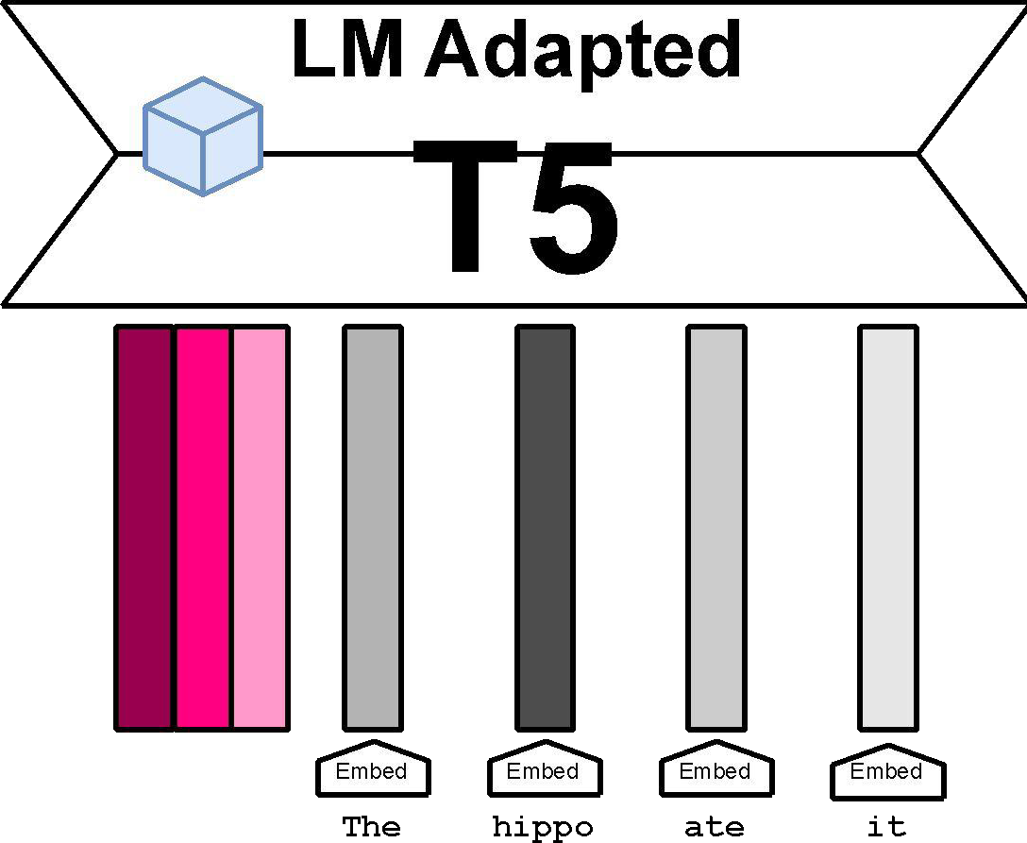
Prompt Tuning

Slide 13
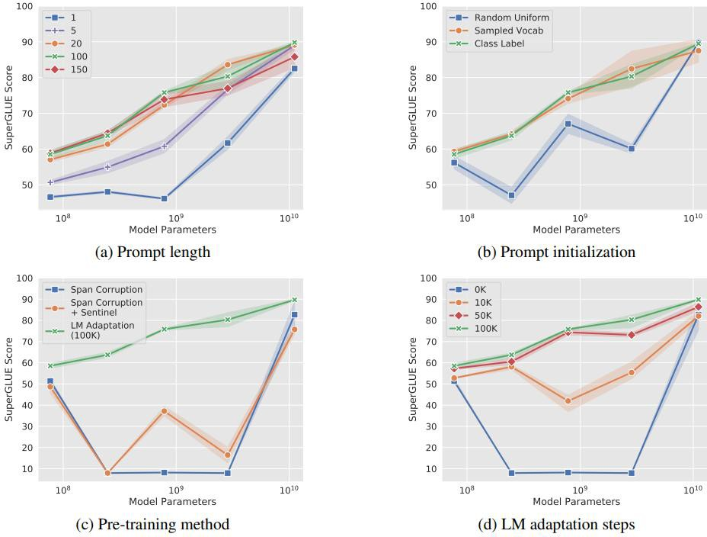
Efficiency of Prompt Tuning

Slide 14
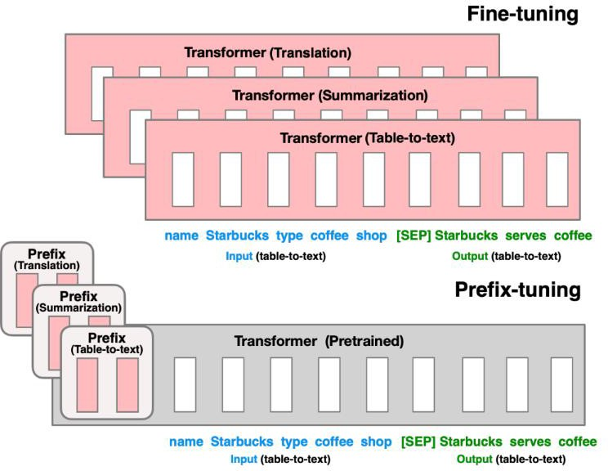
Prefix Tuning

Slide 15
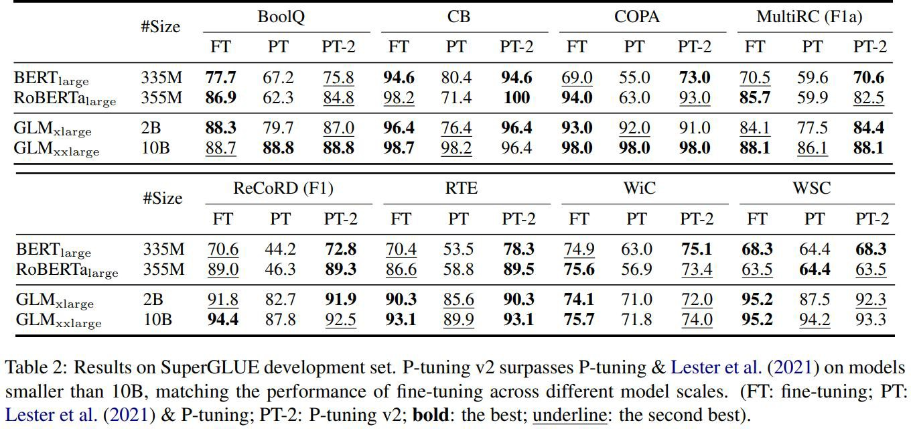
Efficiency of Prefix Tuning

Slide 16
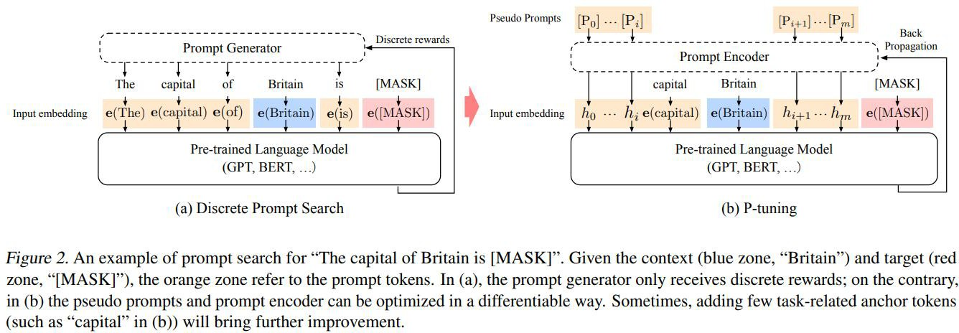
P-Tuning

Slide 17
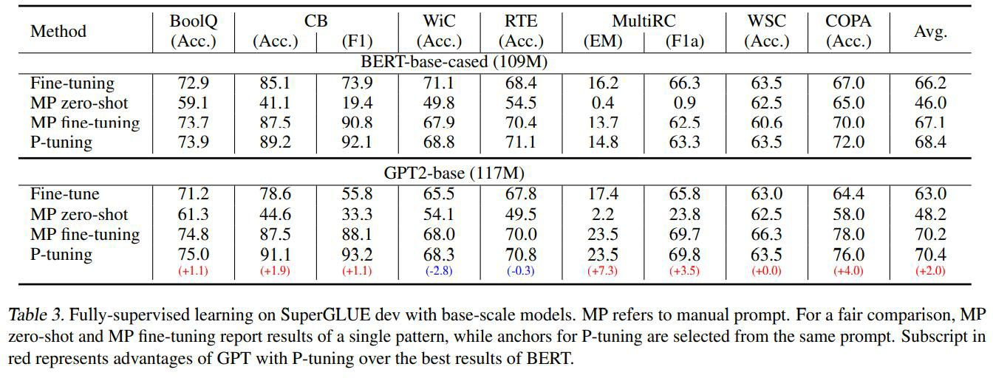
Efficiency of P-Tuning

Slide 18
Advantages of Prefix/Prompt Tuning
The learned embeddings tend to be relatively small, just a few megabytes or less.
It is cheap to keep around one set of embeddings per task.
The pre-trained LLM can be loaded into memory (such as on a server), and at inference time, the appropriate task-specific embeddings can be passed in.
Example use case: User customization

Slide 19
Pitfalls of Prefix and Prompt Tuning
In practice, these methods tend to converge significantly slower than full parameter fine-tuning.
Unclear what the best prefix length is for any particular task.
Every sequence position dedicated to the prefix reduces the number of positions available for your actual task.
Learned embeddings are not very interpretable.

Slide 20
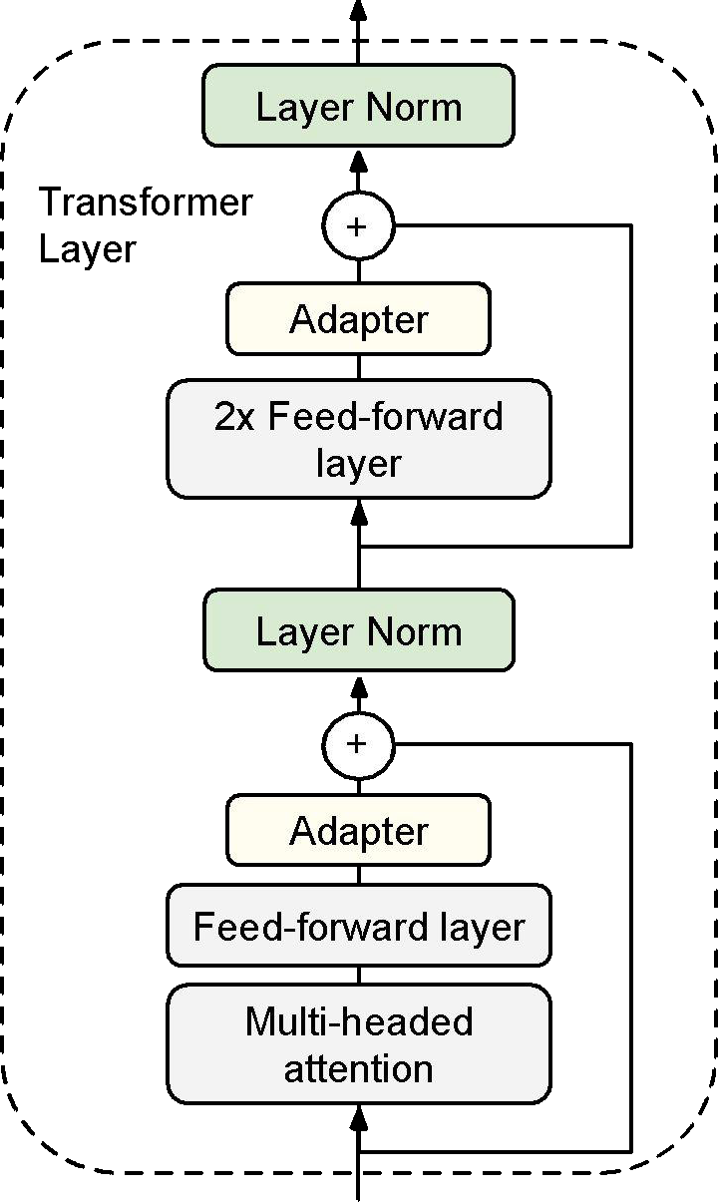
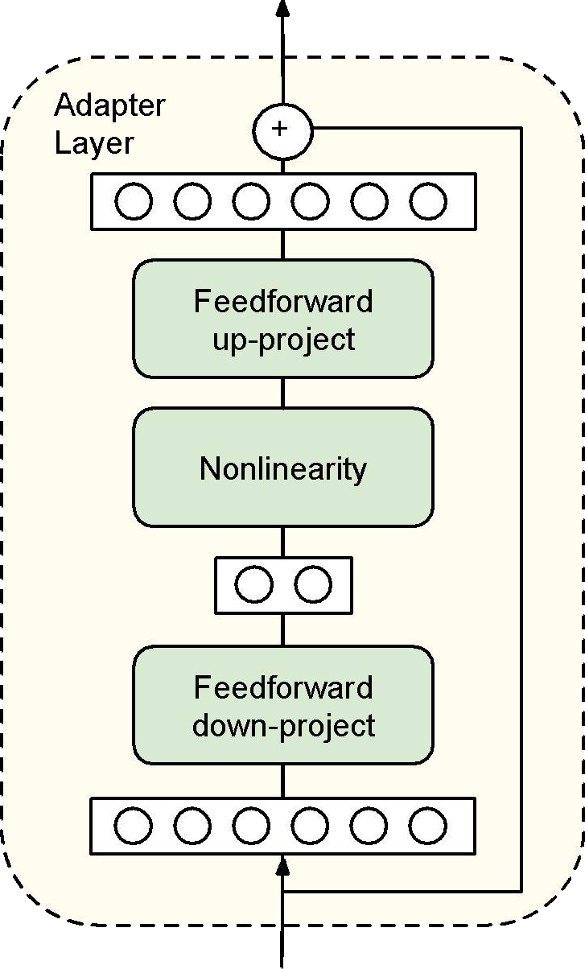
Adapters
Adapters are new modules that are added between layers of a pre-trained network.
The original model weights are fixed; only the weights of the adapter modules are tuned.
The adapters are initialized such that the output of the adapter-inserted module resembles the original model.

Slide 21
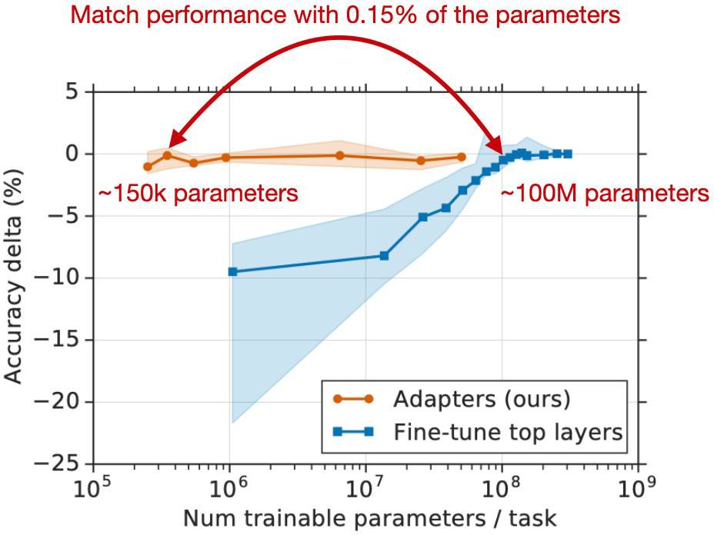
Adapters

Slide 22
Advantages of Adapter-Based Methods
Have been shown to be quite effective in multi-task settings.
There are methods for training task-specific adapters and then combining them to leverage the cross-task knowledge.
Tend to be faster to tune than full model fine-tuning.
Possibly more robust to adversarial perturbations of the tuning data compared to full model fine-tuning.

Slide 23
Pitfalls or Adapter Methods
Adding in new layers means making inference slower.
It also makes the model bigger (possibly harder to fit on available Accelerators, like GPUs, NPUs).
Adapter layers need to be processed sequentially at inference time, which can break model parallelism.

Slide 24
What if we pick a small subset of the parameters of the neural network and just tune those?
Methods: layer freezing, BitFit, diff pruning

Slide 25
Layer Freezing
Research has shown that earlier layers of the Transformer tend to capture linguistic phenomena and basic language understand; later layers are where the task-specific learning happens.
This means we should be able to learn new tasks by freezing the earlier layers and just tuning the later ones.

Slide 26
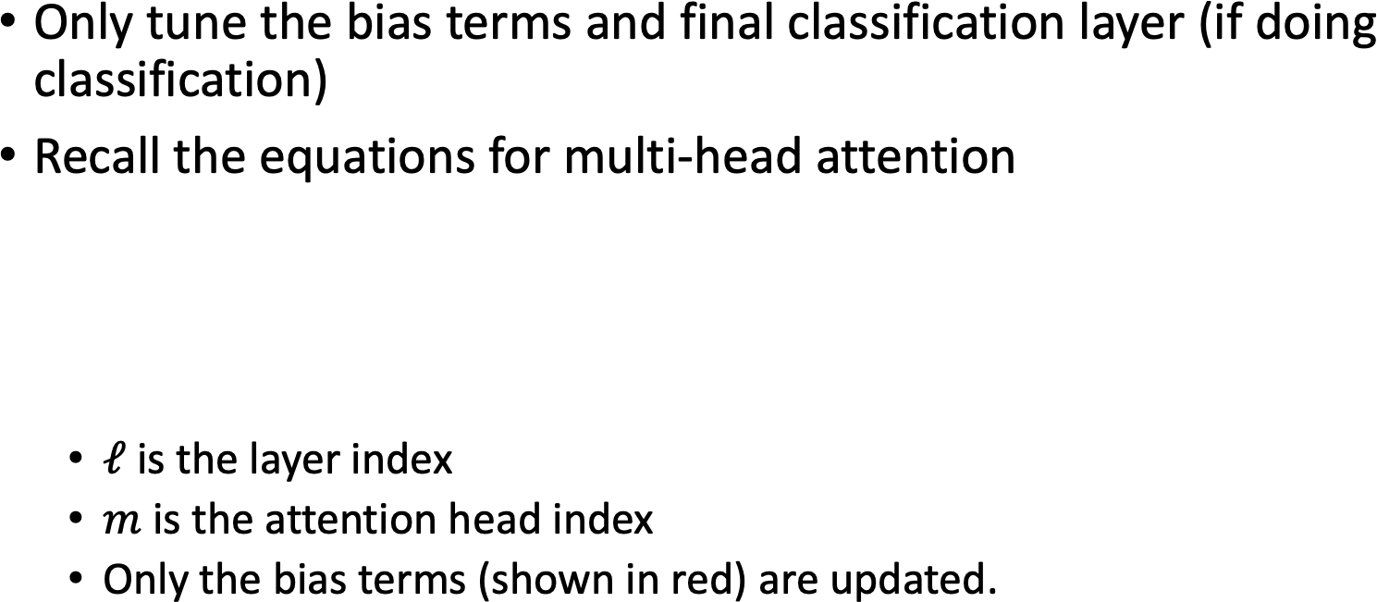
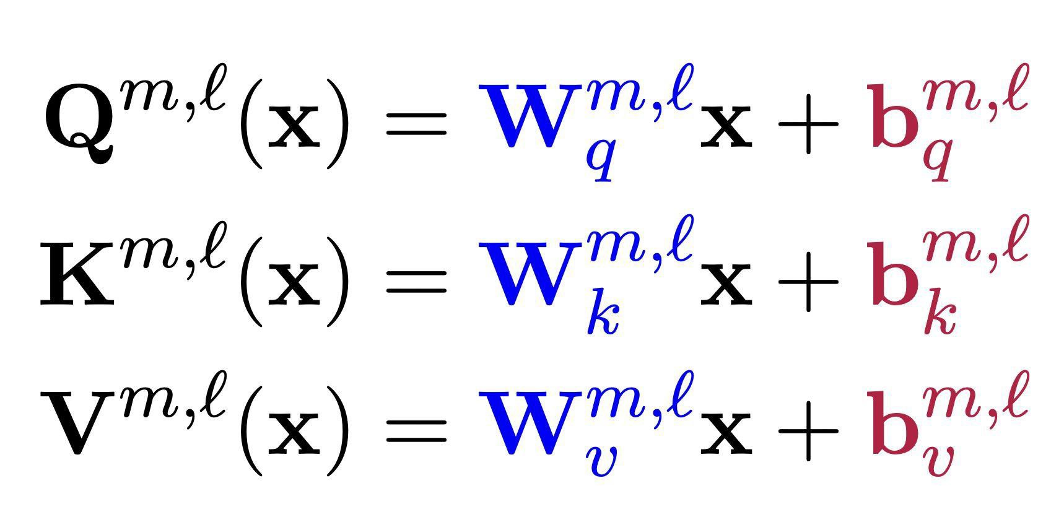
BitFit: Bias-terms Fine-tuning

Slide 27
Intuition for DiffPruning
In prior methods we discussed, the choice of what parameters to freeze and what parameters to tune was done manually.
Why not learn this instead?
Main idea:
For each parameter, finetune a learnable “delta” which gets added to the original parameter value.
Use an L₀-norm penalty to encourage sparsity in the deltas.

Slide 28
What if we re-parameterize the model into something that is more efficient to train?
Methods: LoRa, (IA)³

Slide 29
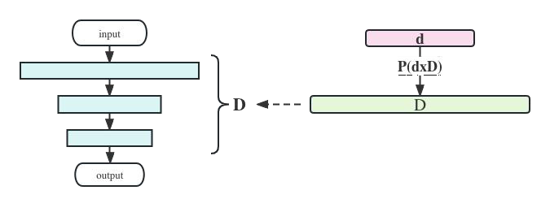
Intuition for Re-Parameterizing the Model
Finetuning has a low intrinsic dimension, that is, the minimum number of parameters needed to be modified to reach satisfactory performance is not very large.
This means, we can re-parameterize a subset of the original model parameters with low-dimensional proxy parameters, and just optimize the proxy.

Slide 30
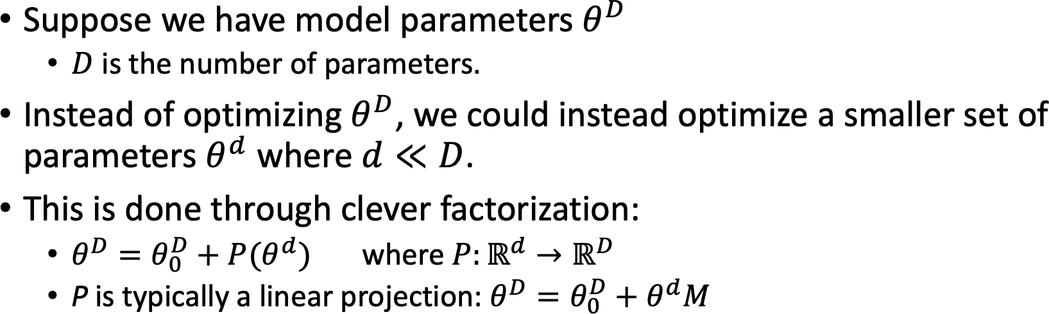
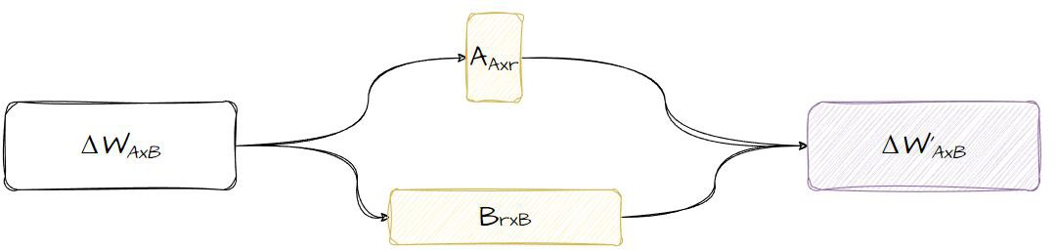
LoRA - Low-Rank Adaptation

Slide 31
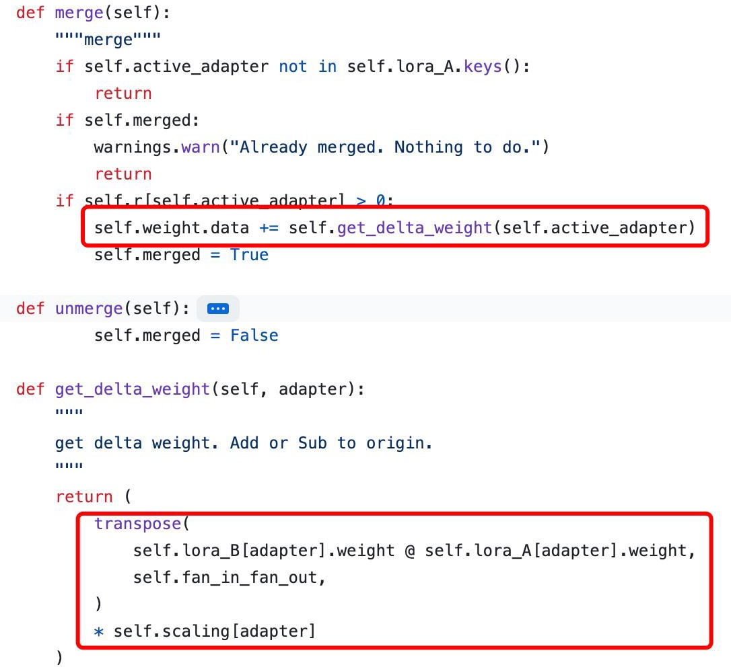
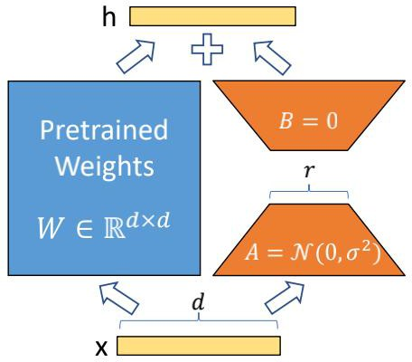
LoRA

Slide 32
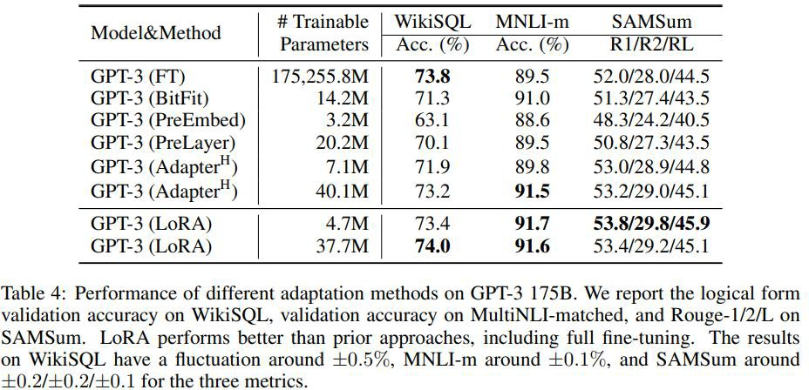
Efficiency of LoRA

Slide 33
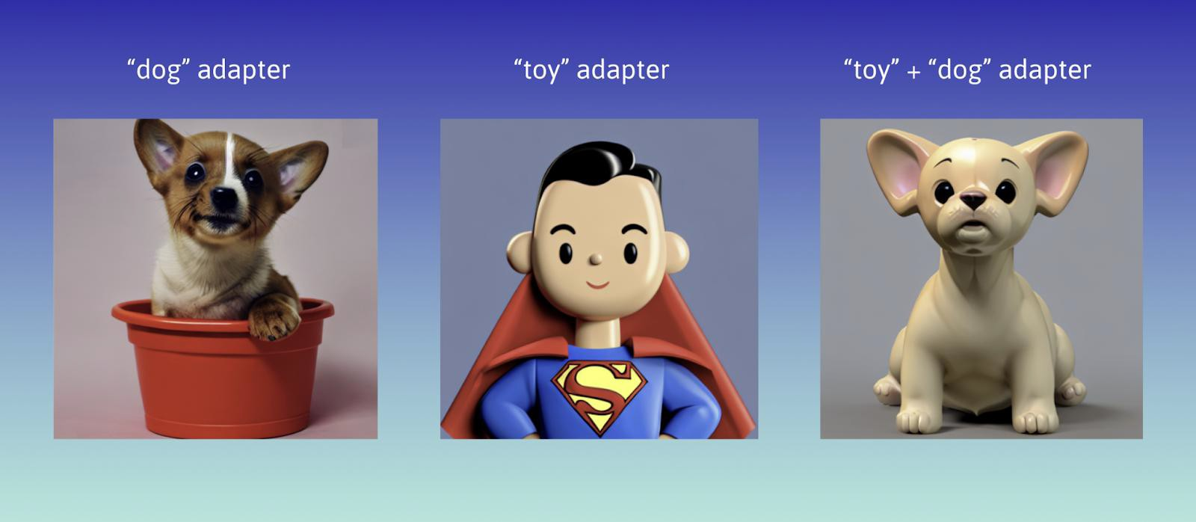
LoRA in Stable Diffusion

Slide 34
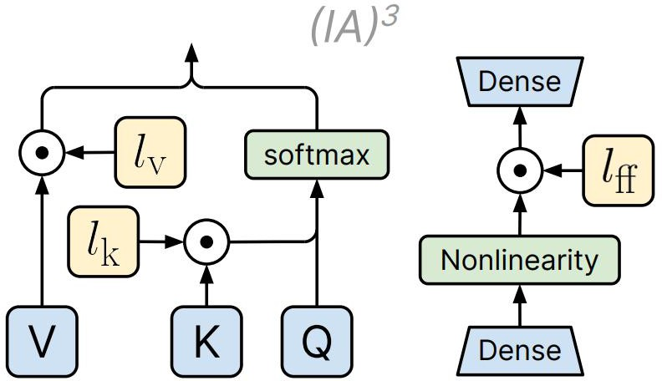
(IA)³ - Infused Adapter by Inhibiting or Amplifying Inner Activations

Slide 35
(IA)³ - Infused Adapter by Inhibiting or Amplifying Inner Activations
Intended to be an improvement over LoRA
Three goals:
must add or update as few parameters as possible to avoid incurring storage and memory costs
should achieve strong accuracy after training on only a few examples of a new tasks
must allow for mixed-task batches
Main idea:
Rescale inner activations with lower-dimensional learned vectors, which are into the attention and feedforward modules
Main differences from LoRA:
LoRA learns low-rank updates to the attention weights
(IA)³ learns injectable vectors.
injected

Slide 36
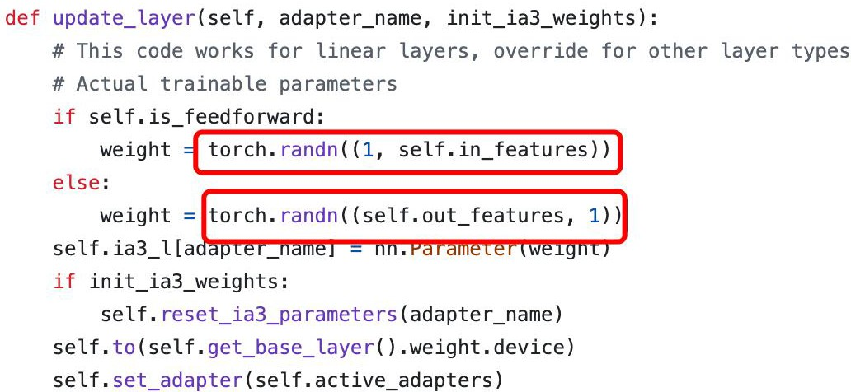
(IA)³

Slide 37
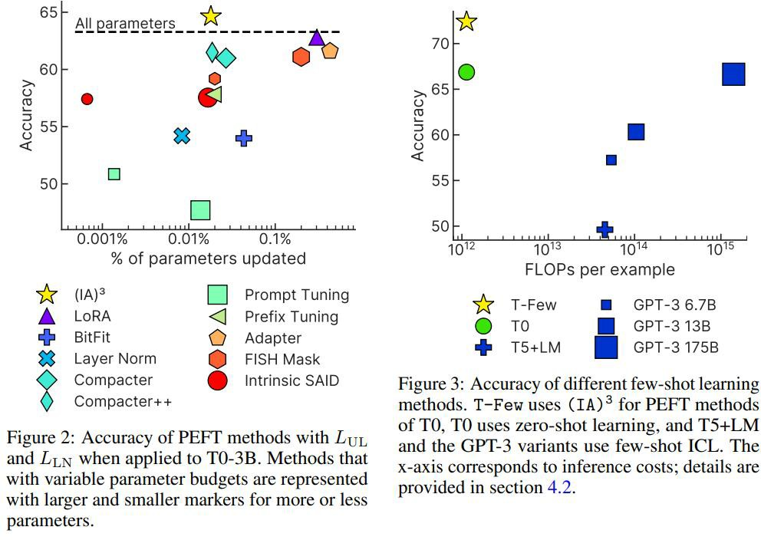
Efficiency of IA3

Slide 38
Advantages of Re-Paramaterization Methods
Training tends to be more memory-efficient, since we only need to calculate gradients and maintain optimizer state for a small number of parameters.
These methods are faster to tune than standard full model finetuning.
It is straight-forward to swap between tasks by swapping in and our just the tuned weights.

Slide 39
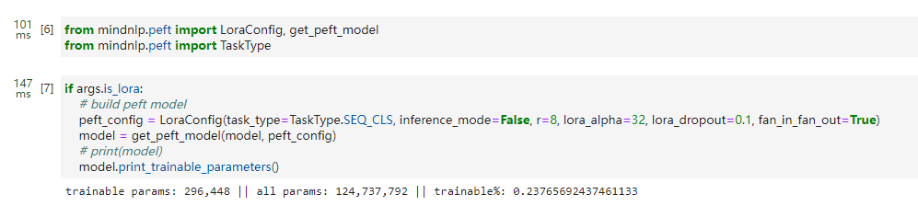
MindNLP Demo1
Just like huggingface peft

Slide 40
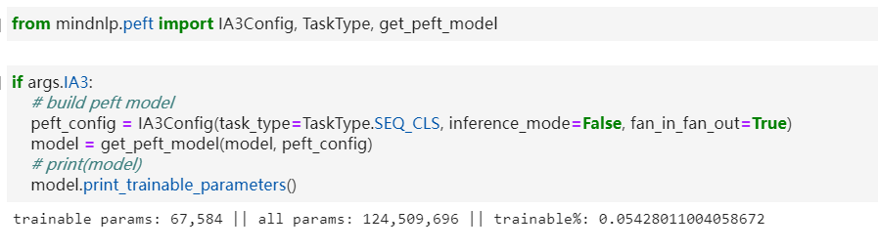
MindNLP Demo2
Just like huggingface peft

Slide 41
Thank you

